Slide 1
IoT Design Methodology

Slide 2
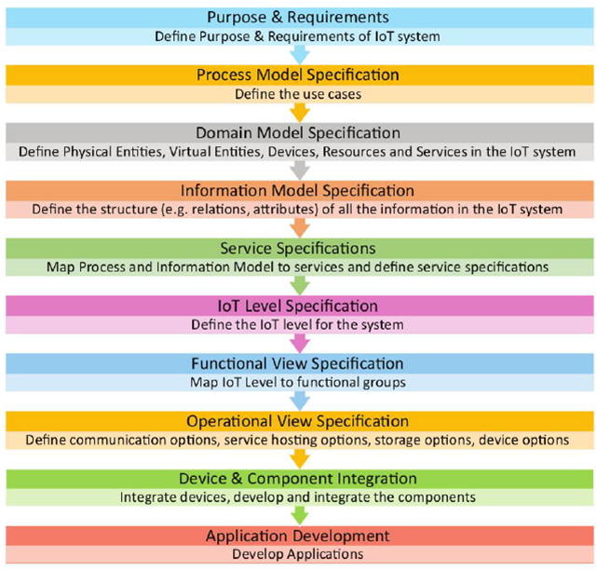

Slide 3
1. Purpose and Requirements Specification
Requirements can be
Data collection requirements
Data analysis requirements
System management requirements
Security requirements
User interface requirements

Slide 4
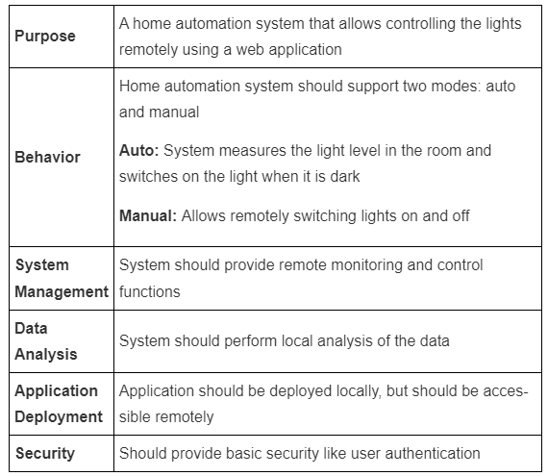

Slide 5
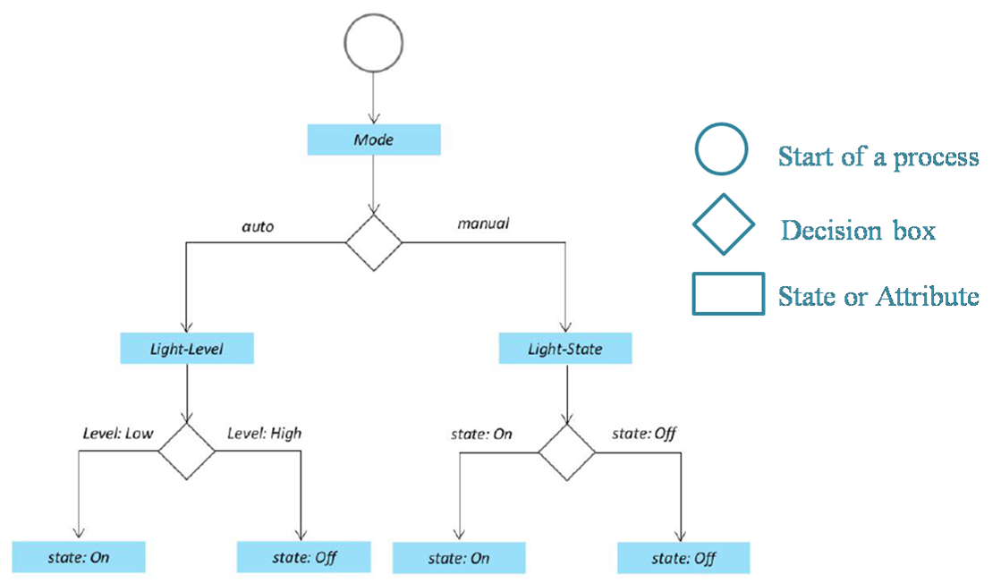
2. Process Specification

Slide 6
3. Domain Model Specification
The domain model describes the main concepts, entities, and objects in the domain of the IoT system to be designed. The domain model defines the attributes of the objects and the relationships between objects.

Slide 7
Physical Entity | • The physical identifiable objects in the environment • IoT system provides information about the physical entity (using sensors) or performs actuation upon the physical entity
Virtual Entity | • Virtual entity is a representation of the physical entity in the digital world • For every physical entity there is a virtual entity
Device | • Devices provide a medium for interaction between physical and virtual entities • Devices are used to gather information from or perform actuation on physical entities
Resource | • Resources are software components which can be either on-device or network-resources • On-device resources are hosted on the device and provide sensing or actuation (eg: operating system) • Network-resources include software components that are available on the network (eg: database)
Service | • Services provide an interface for interacting with the physical entity • Services access resources to perform operations on physical entities

Slide 8
4. Information Model Specification
Information model defines the structure of all the information in the IoT system. It does not describe how the information is stored and represented. To define the information model, we first list the virtual entities.

Slide 9
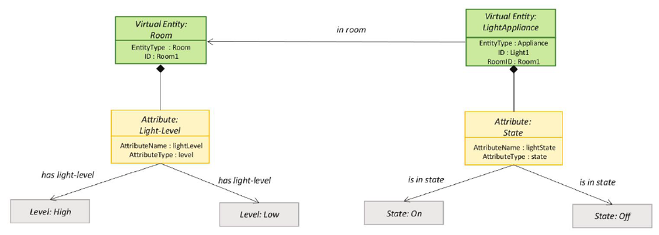

Slide 10
5. Service Specifications
For each state and attribute in the process specification and information model, we define a service. Services either change the state of attributes or retrieve their current values.

Slide 11
6. IoT Level Specification
Based on the requirements we will choose the IoT application deployment level.

Slide 12
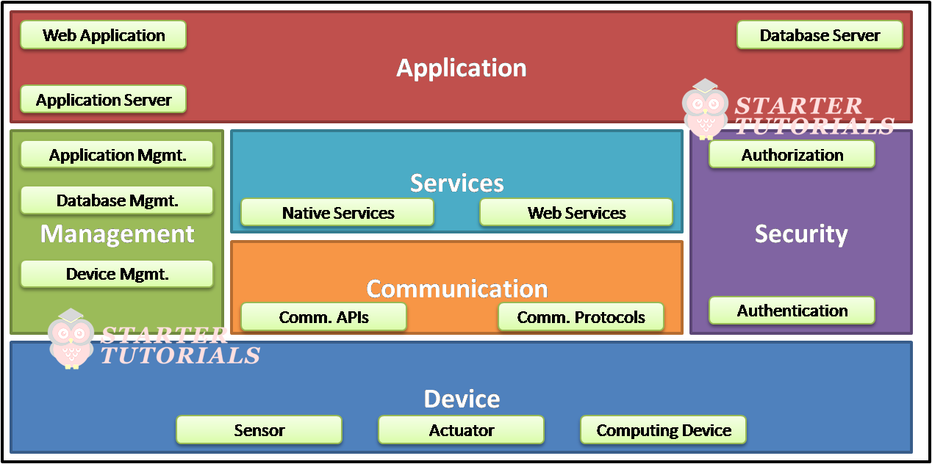
7. Functional View Specification
The functional groups in a functional view include
Device, Communication, Services, Management, Security, and Application.

Slide 13
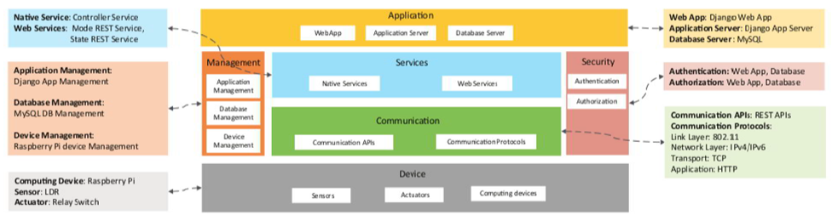
8. Operational View Specification

Slide 14
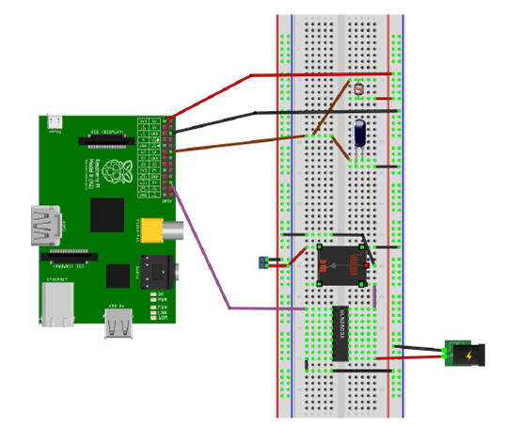
9. Device and Component Integration
The devices like sensors, computing devices and other components are integrated together.

Slide 15
10. Application Development
Using all the information from previous steps, we will develop the application (code) for the IoT system.

